Slide 1
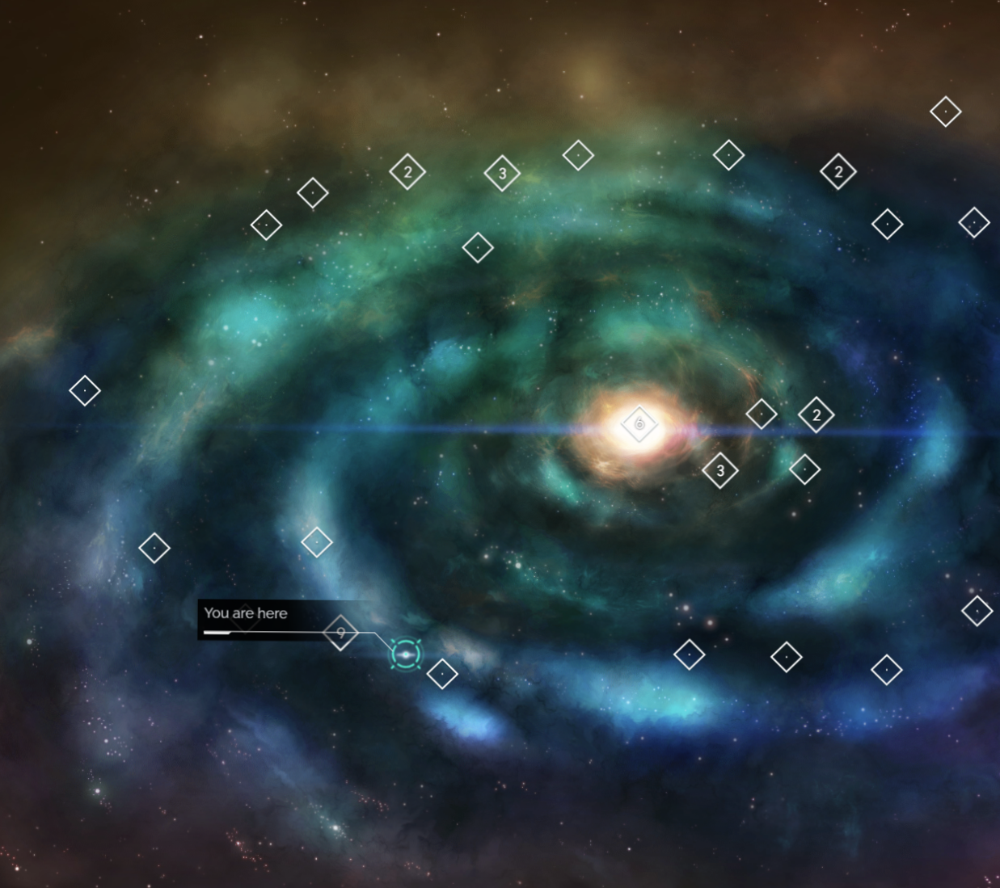
No Man's Sky Interactive 3D Galaxy Map
Using Computer Vision to
Extract Galactic Coordinates from Screen Captures
Plotting Personal & Collective Explored Space in 3D Space
Derek Borders
CSCI 490
Capstone Project

Slide 2
Content 2
Problem
Architecture
Growth Areas
As an NMS player, I would like to be able to visualize both the parts of the in-game galaxies I have personally explored, and the parts of the galaxy explored by the community as a whole.
I want to be able to visualize this massive scale of information in a way that is clean, intuitive, and visually compelling.
Python
Pandas, Numpy
PyTorch
Plotly Dash
TensorFlow / OpenCV
Nvidia RAPIDS suite
for GPU acceleration
Django (or React)
HTML/JS/CSS
Bootstrap / Material
Docker
Deeper dive into computer vision
New tools I’ve been wanting to try
Neural Network / Transformer
3D Point Cloud Visualization practice
Web Scraping & Processing
Large scale, dynamic implementation
Additional UI/UX practice

Slide 3
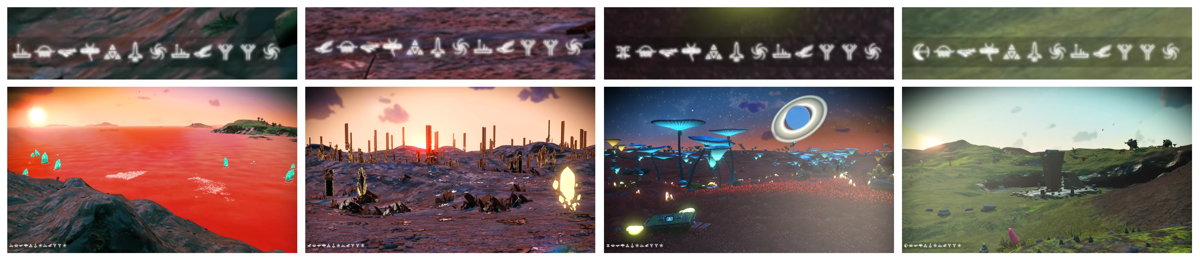
No Man’s Sky has a unique feature with its screen captures. When a screen capture is recorded in a specific way, coordinates are overlaid in the bottom left corner. These coordinates use in-game symbols that constitute a hexadecimal number system.

Slide 4
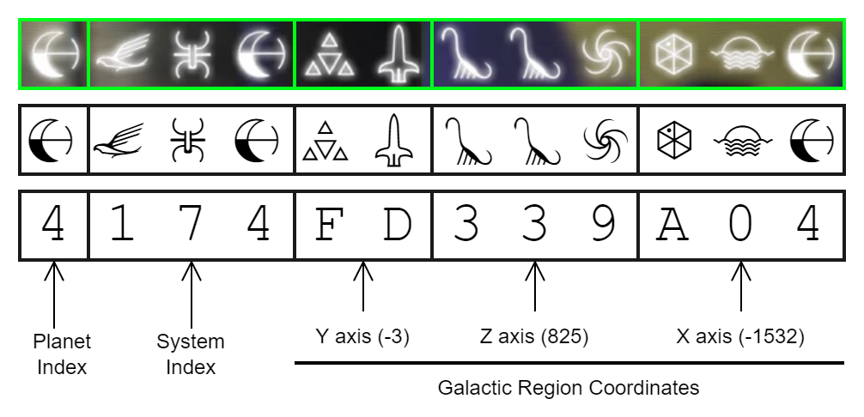
Using computer vision via neural network or transformer, I will extract these symbols from screenshots, convert them to their hexadecimal equivalent, and extract X, Y, and Z coordinates from the last 8 digits. Using this method, I will construct interactive maps of space I have personally explored. I will then scrape r/NMScoordinateexchange for similar images to construct a map of that sample of collectively explored space. If all else goes well, I will then construct a dashboard style web interface to allow others to use this tool.

